Slide 1


A report on
Student counselling system
Submitted By
Submitted To
Sparsh Kumar 20BCS219
Dhruv Rishishwar 20BCS075
Anshul Shukla 20BCS035
CSE batch 2020
Prof. Pritee Khanna
PDPM Indian Institute of Information Technology, Design
and Manufacturing JABALPUR, INDIA
November 16th, 2021

Slide 2

Introduction
The name of our website is ON THE WAY
This project is an implementation of an online student counselling system made by students of IIITDM Jabalpur.
With this website, a student can get help of an expert counsellor from the comfort of his/her home and with absolute privacy.

Slide 3
Purpose
The main objective of our project is to help students who are facing problems related to academics or college life like stress, peer pressure, problem in deciding their goal, poor performance in studies etc. by providing expert guidance from our counsellors.
The scope of this website is bound to the welfare students of IIITDM Jabalpur only.
All the registered students and expert counsellors are from our college.
It can provide you with a personalized feedback based on a pre-defined quiz that a student takes and you can also chat directly with an expert.
Scope

Slide 4
Users
There are three types of users of our website :
1. Admin : The admin manages all activities happening on the website like :
i. Approving a newly registered counsellor.
ii. Viewing and deleting feedbacks, etc.
2. Counsellor : Counsellor is an expert who helps students in any way they need help.
3. Student : Student reach out to the counsellors for help.

Slide 5
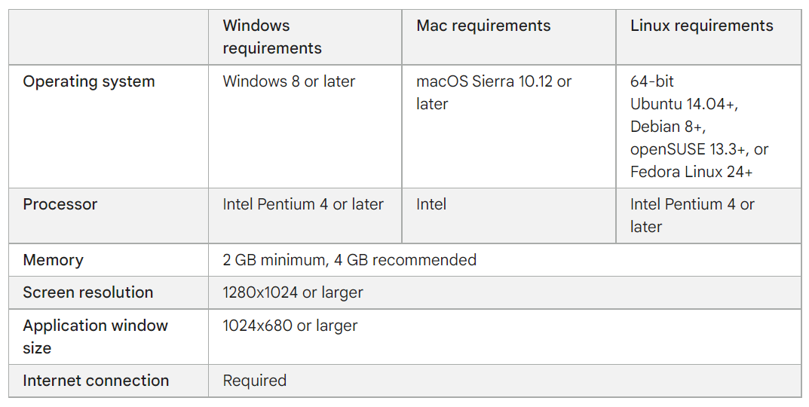
Overall Description
System features and Requirements
A web browser and

Slide 6
Overall Description
Functional Modules
Our project has mainly 3 modules:
1. Student Module -
Student can take quiz multiple times and get personlized feedback.
Student can view all registered counsellors and chat directly with anyone.
Student have the ability to edit their profile and can give feedbacks regarding website or counselling.
2. Counsellor Module -
Counsellor can view the details of all students and chat with anyone they feel like needs help.
Counsellor also give feedbacks.
3. Admin Module -
Admin can approve or decline a counsellor’s request to become a counsellor on their website.
Admin has the ability to remove a student or a counsellor.
Admin can change the questions and their options.

Slide 7
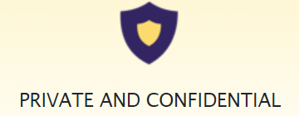
Overall Description
External Interface requirements
A user to operate the website.
All the system requirements mentioned previously.
A web browser (eg. Google chrome, mozilla firefox, brave etc.)
Non-functional requirements
Performance : This is a fast website.
Security : It provides complete privacy.
Quality : It has a clean UI with good UX.

Slide 8




Technology Stack
Frontend
CSS
Javascipt
React.JS
HTML
Backend
MySQL
NodeJS
Express.JS
PHPmyadmin

Slide 9
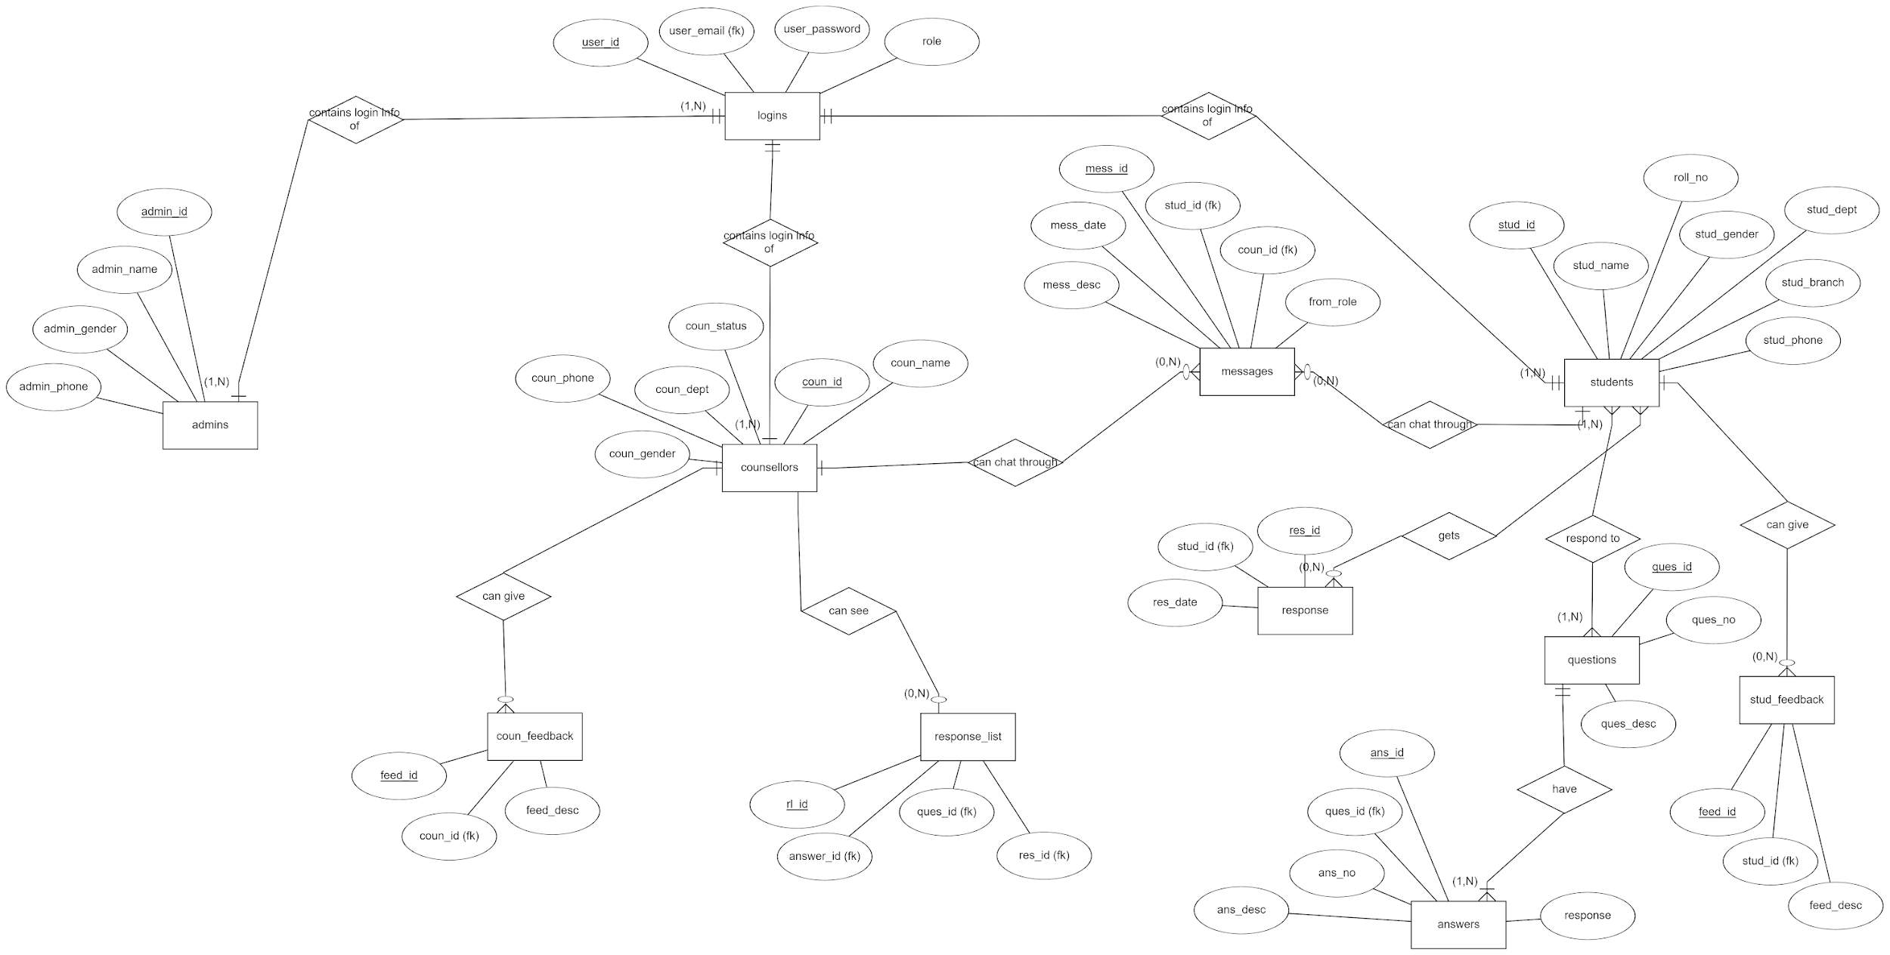
Database Designing (ER-Diagram)

Slide 10
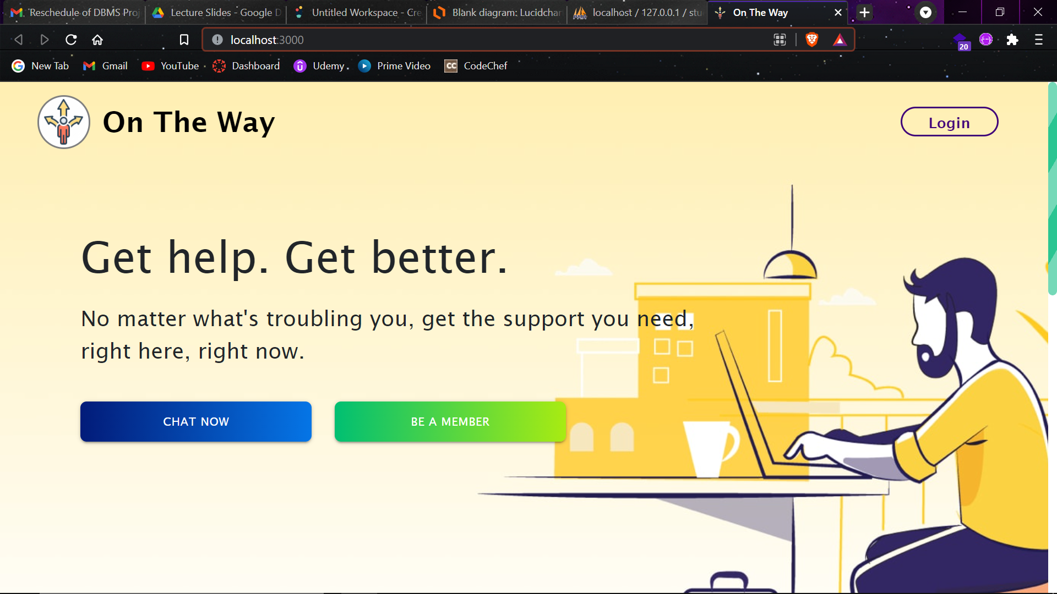
Screenshot of our landing page

Slide 11
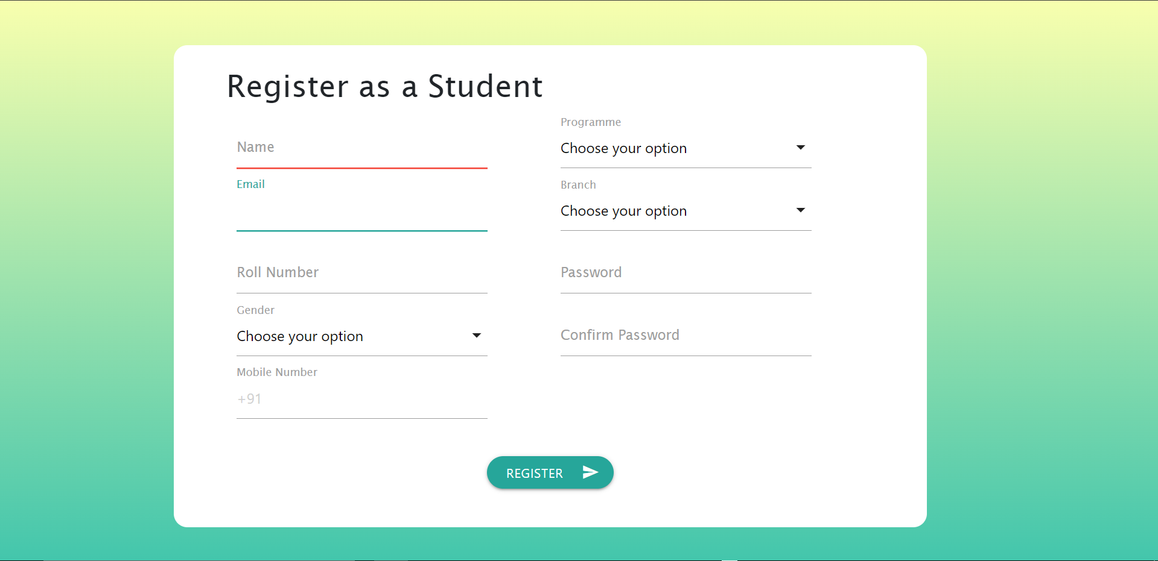
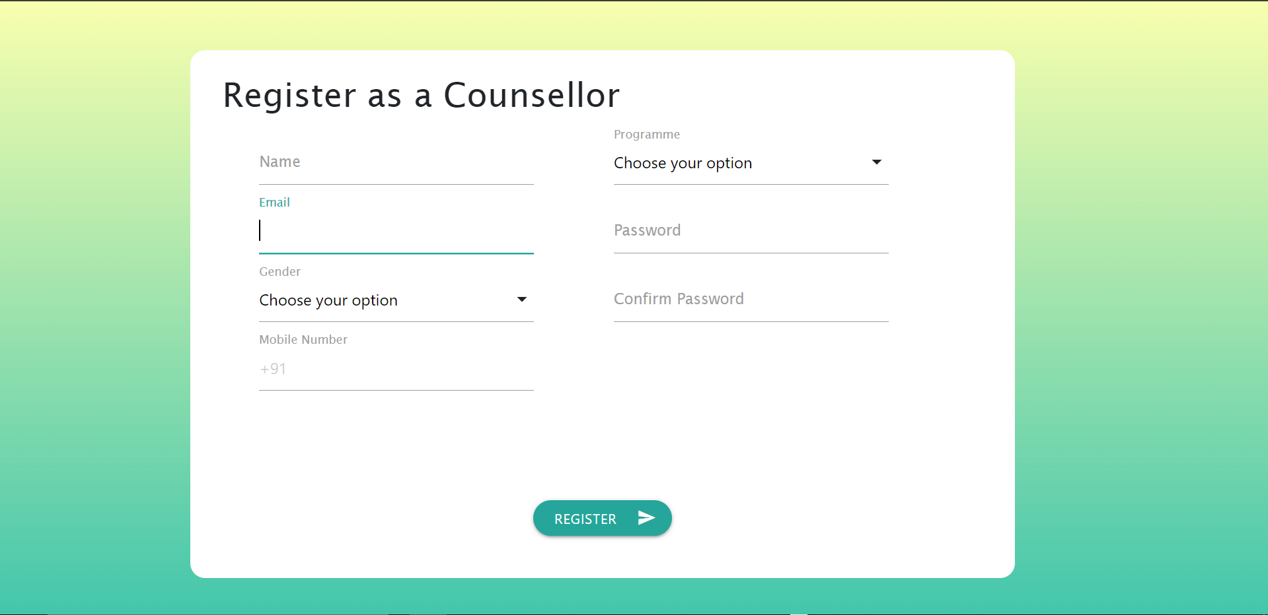
Screenshots of our website

Slide 12
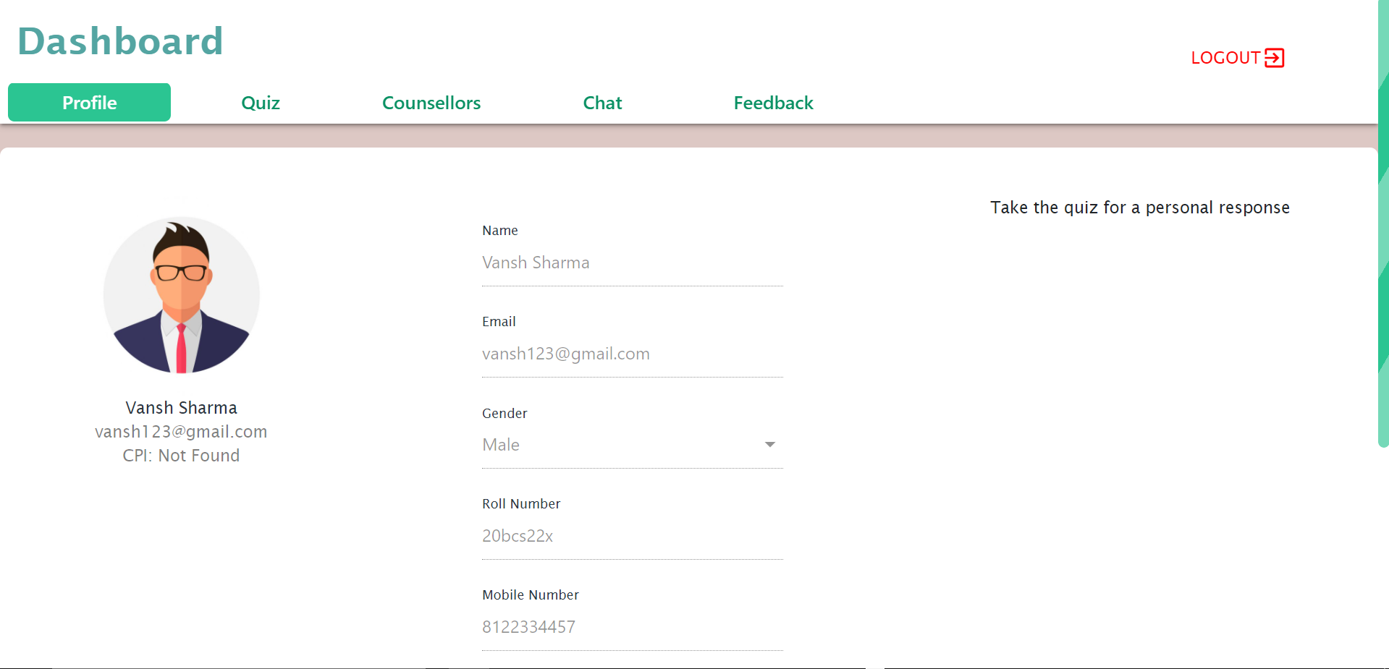
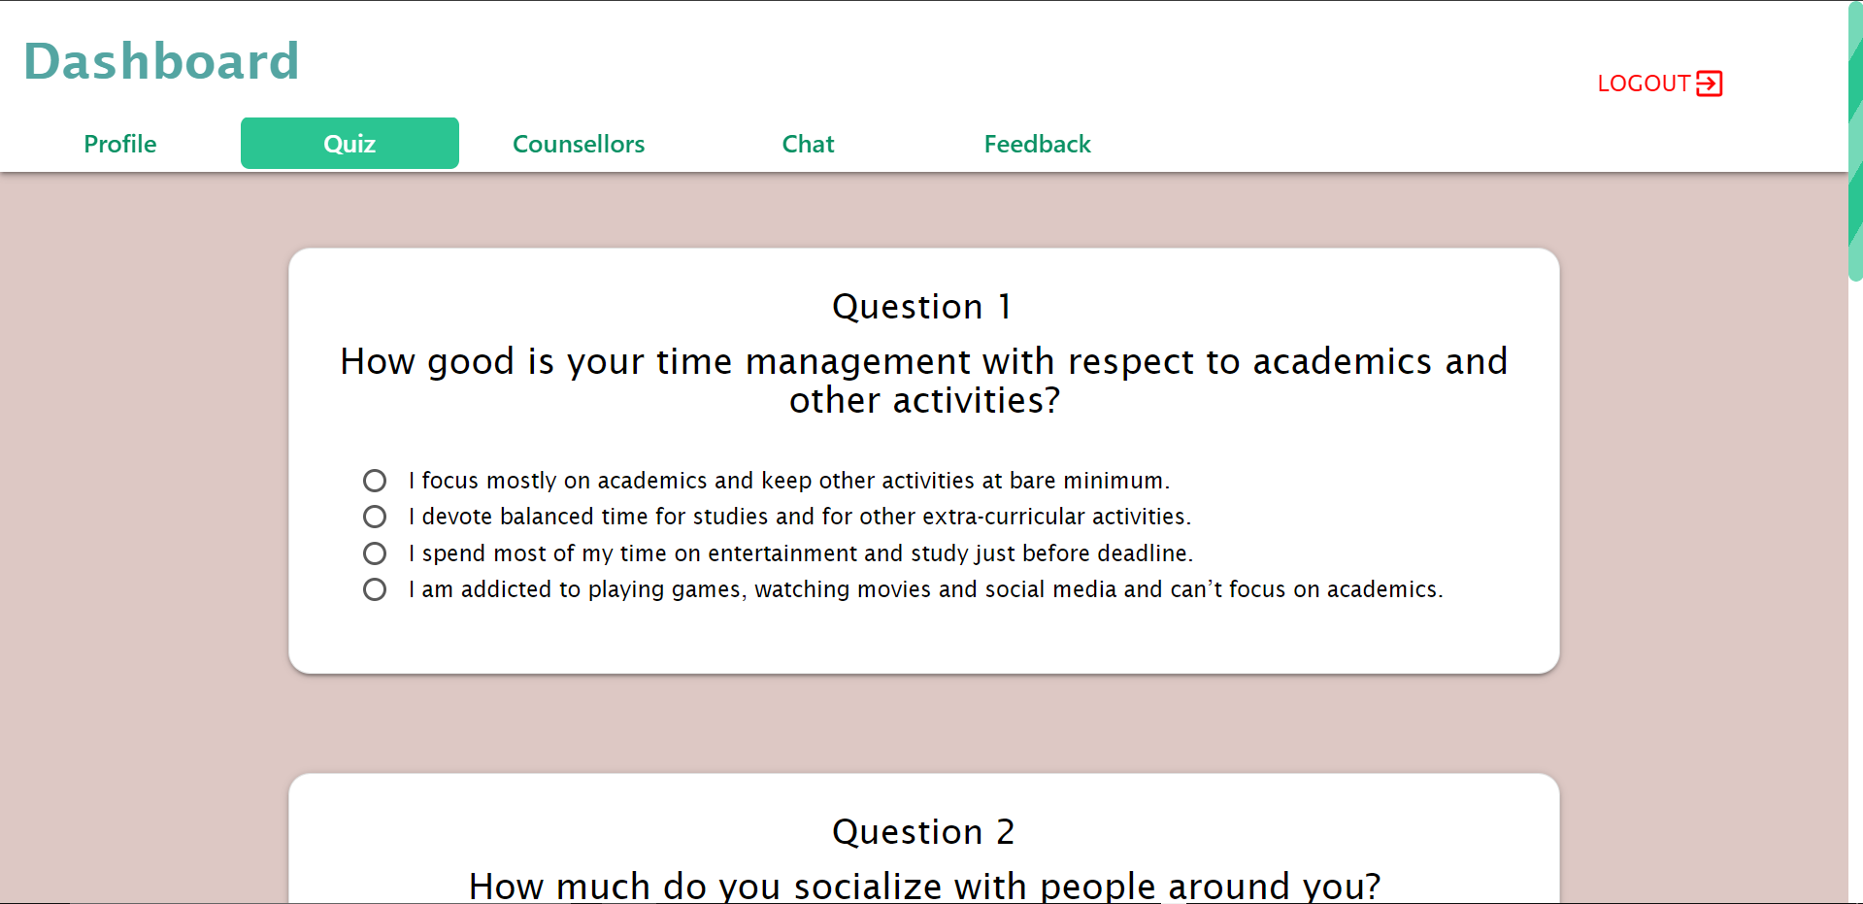
Screenshots of our website
Dashboard of a student profile

Slide 13
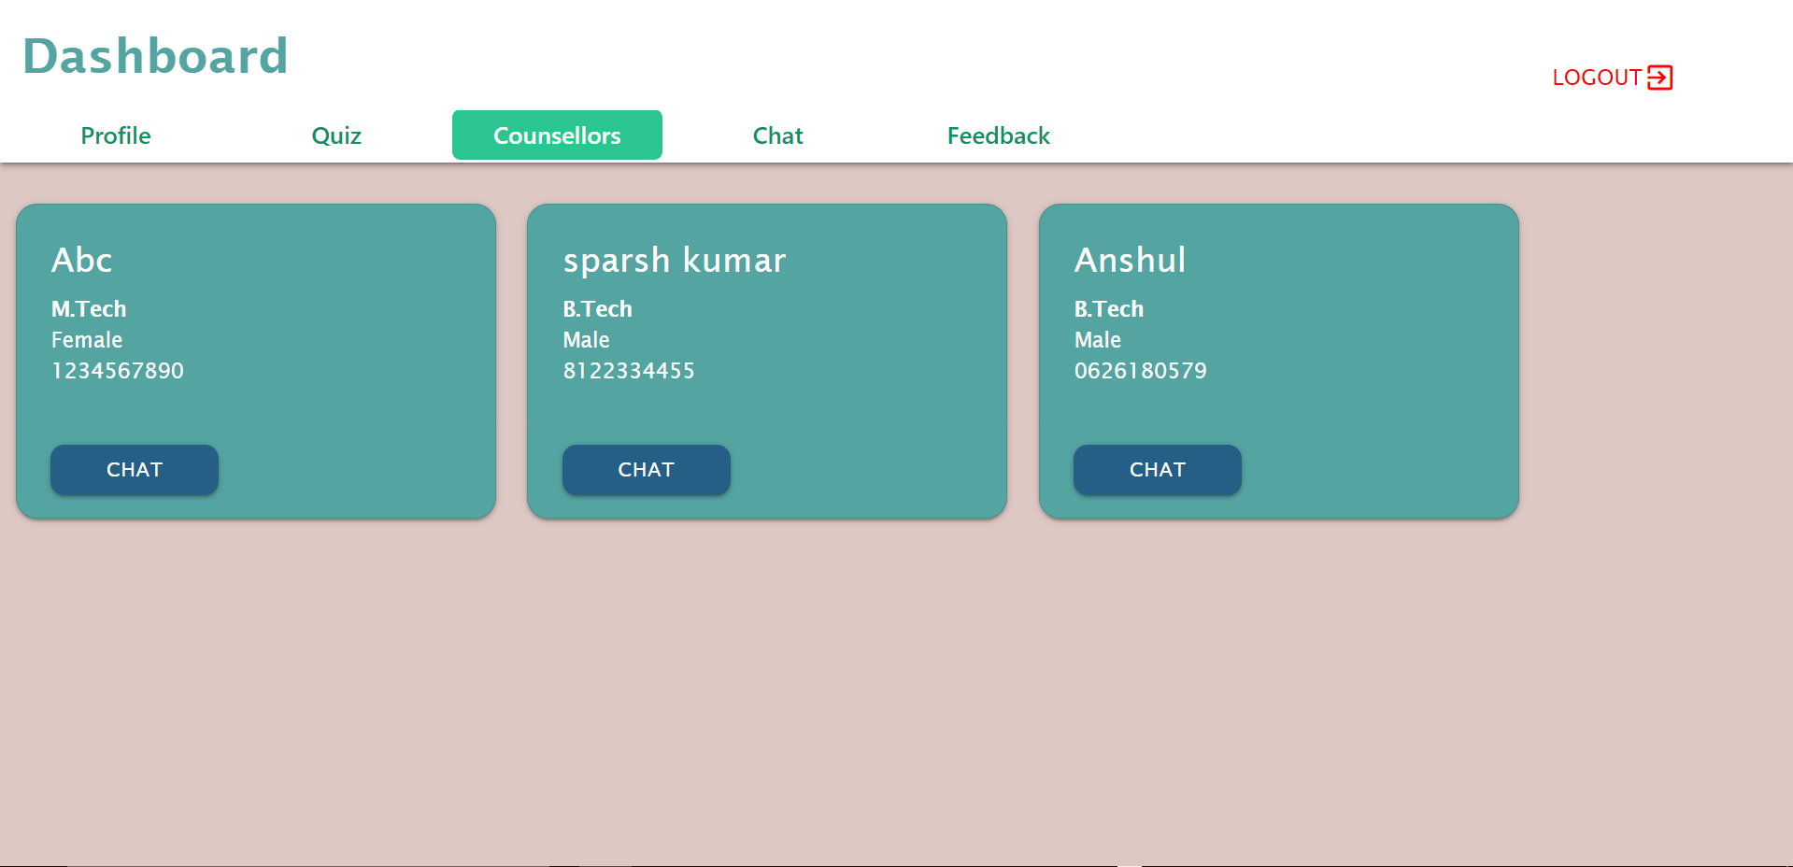
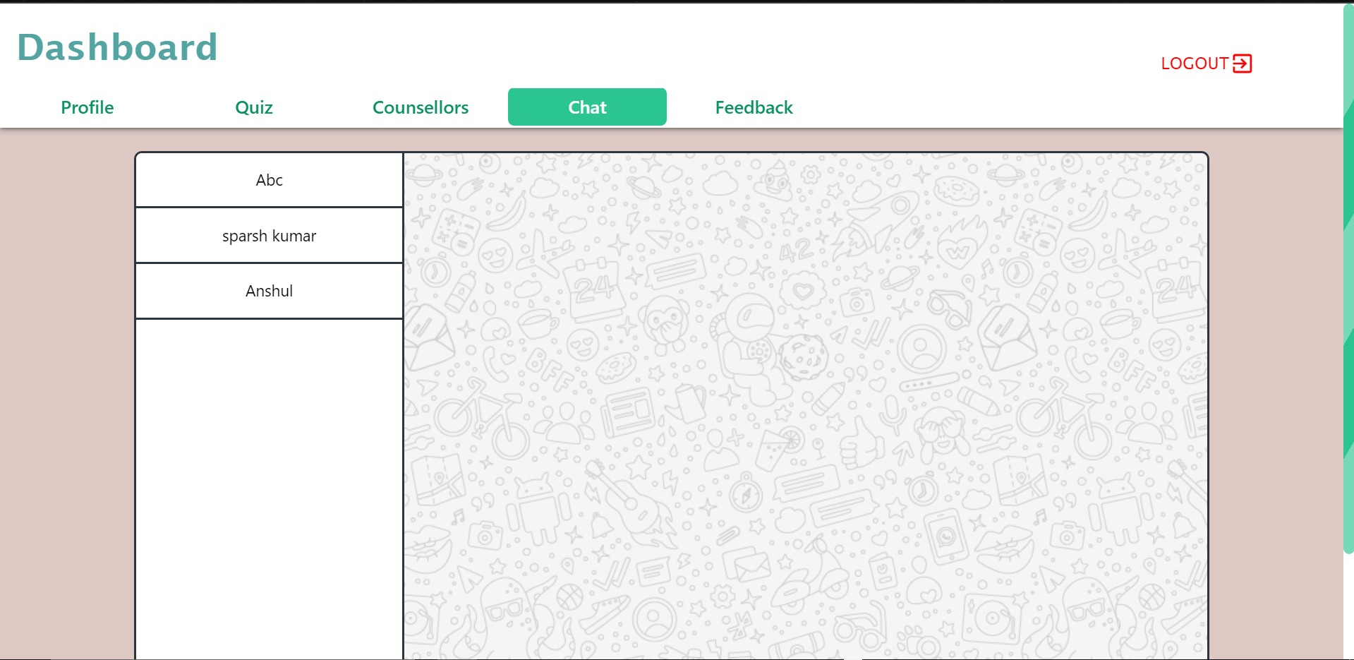
Screenshots of our website
List of counsellors as seen by a student

Slide 14
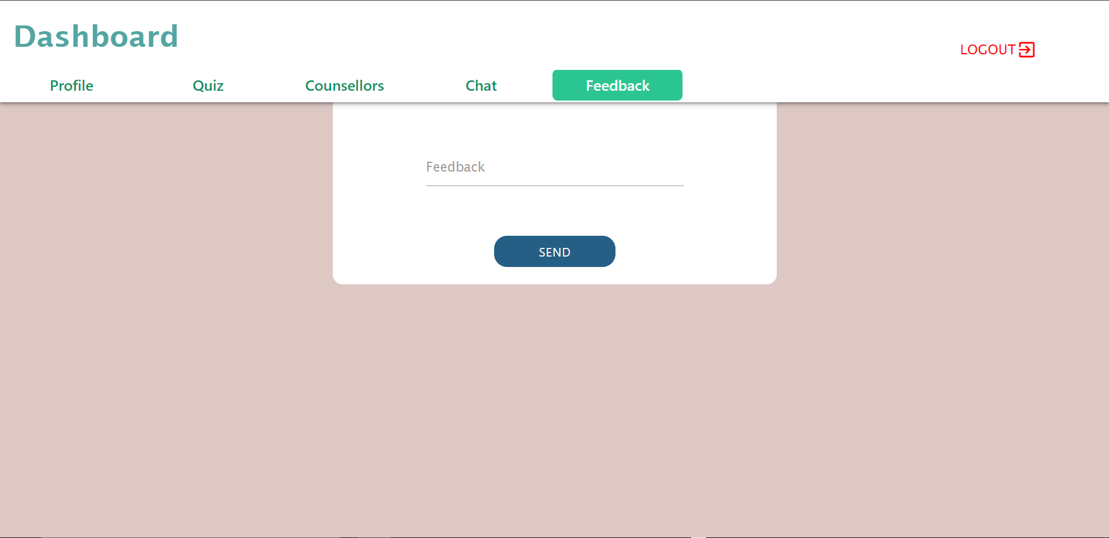
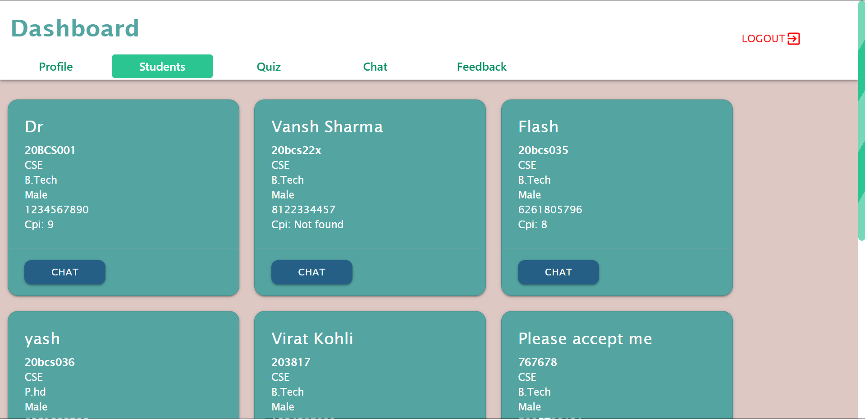
Screenshots of our website
Feedback box
List of students as seen by a counsellor

Slide 15
Thank You

